Slide 1


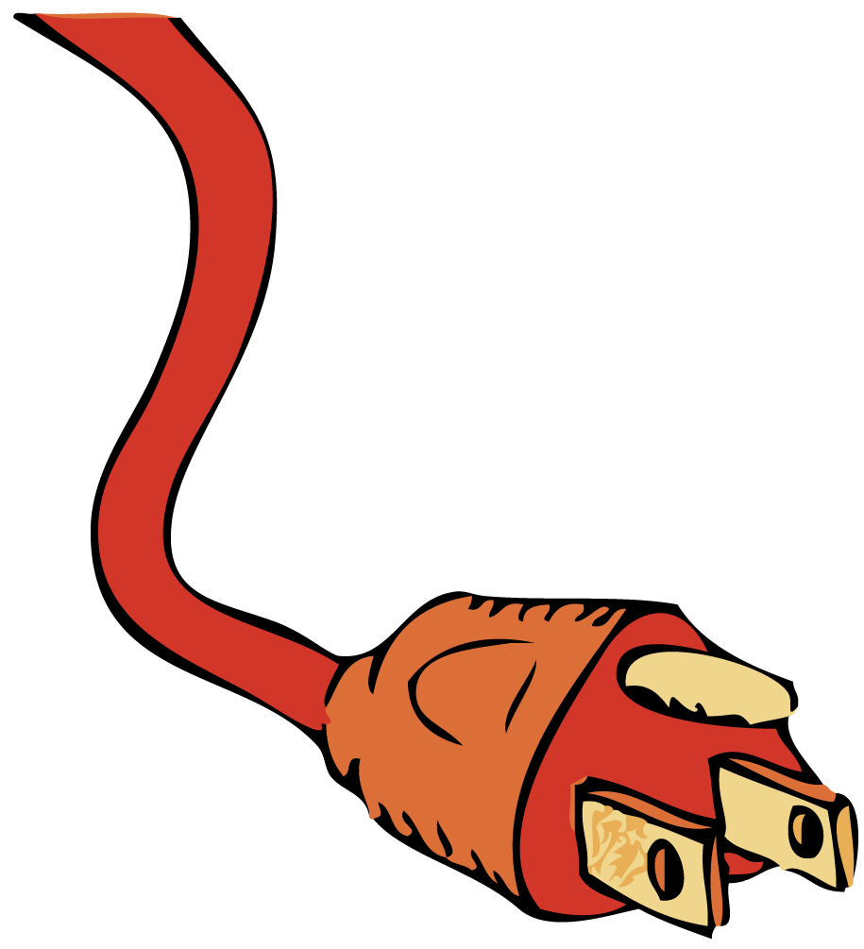

Any path along which electrons can flow is a circuit.

Slide 2

A Battery and a Bulb
In a flashlight, when the switch is turned on to complete an electric circuit, the mobile conduction electrons already in the wires and the filament begin to drift through the circuit.

Slide 3
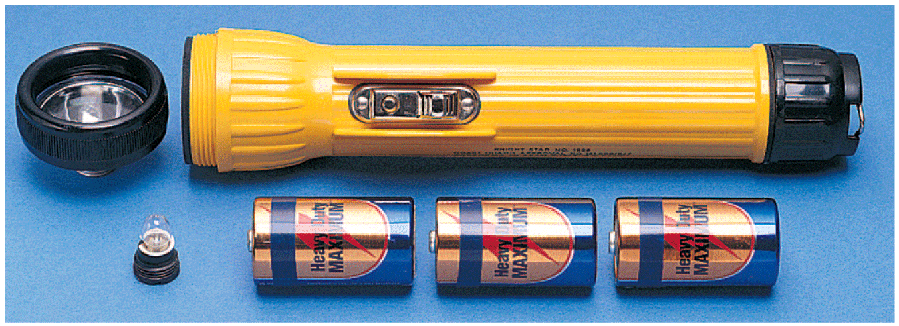
A Battery and a Bulb
A flashlight consists of a reflector cap, a light bulb, batteries, and a barrel-shaped housing with a switch.

Slide 4
A Battery and a Bulb
There are several ways to connect the battery and bulb from a flashlight so that the bulb lights up.
The important thing is that there must be a complete path, or circuit, that
  includes the bulb filament
  runs from the positive terminal at the top of the battery
  runs to the negative terminal at the bottom of the battery

Slide 5
A Battery and a Bulb
Electrons flow
  from the negative part of the battery through the wire
  to the side (or bottom) of the bulb
  through the filament inside the bulb
  out the bottom (or side)
  through the wire to the positive part of the battery
The current then passes through the battery to complete the circuit.

Slide 6
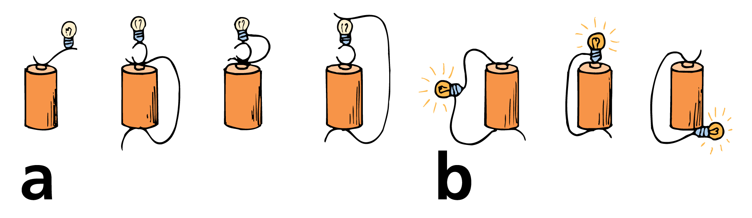
A Battery and a Bulb
Unsuccessful ways to light a bulb.
Successful ways to light a bulb.

Slide 7
A Battery and a Bulb
The flow of charge in a circuit is very much like the flow of water in a closed system of pipes.
In a flashlight, the battery is analogous to a pump, the wires are analogous to the pipes, and the bulb is analogous to any device that operates when the water is flowing.
When a valve in the line is opened and the pump is operating, water already in the pipes starts to flow.

Slide 8
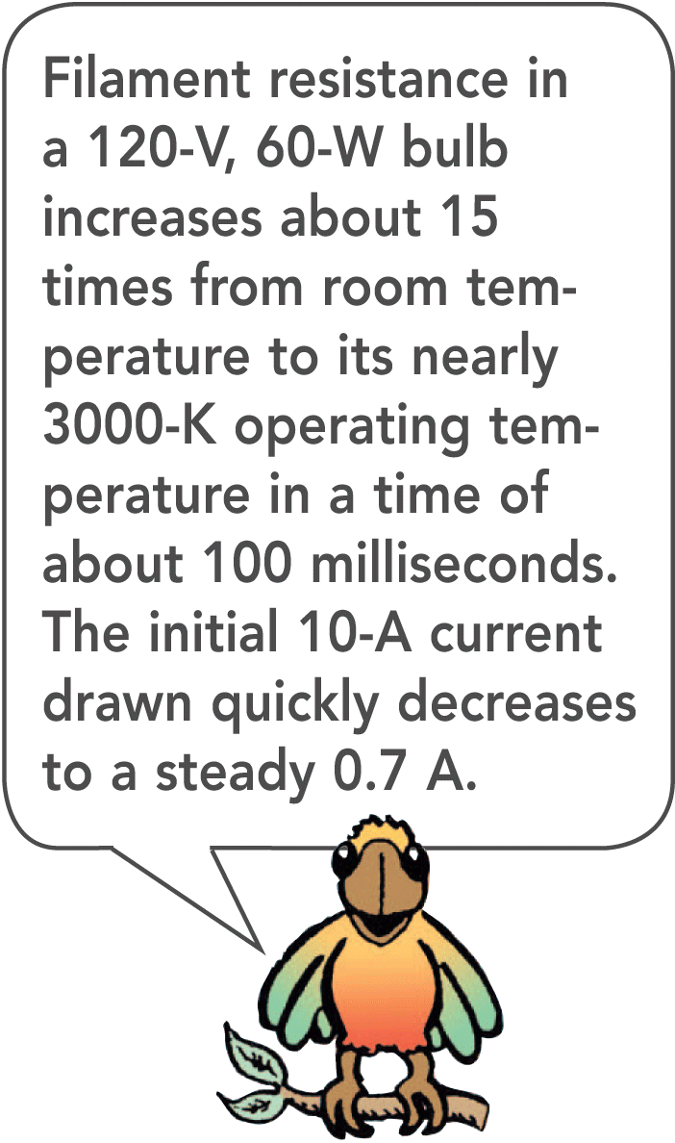
A Battery and a Bulb
Neither the water nor the electrons concentrate in certain places.
They flow continuously around a loop, or circuit.
When the switch is turned on, the mobile conduction electrons in the wires and the filament begin to drift through the circuit.

Slide 9
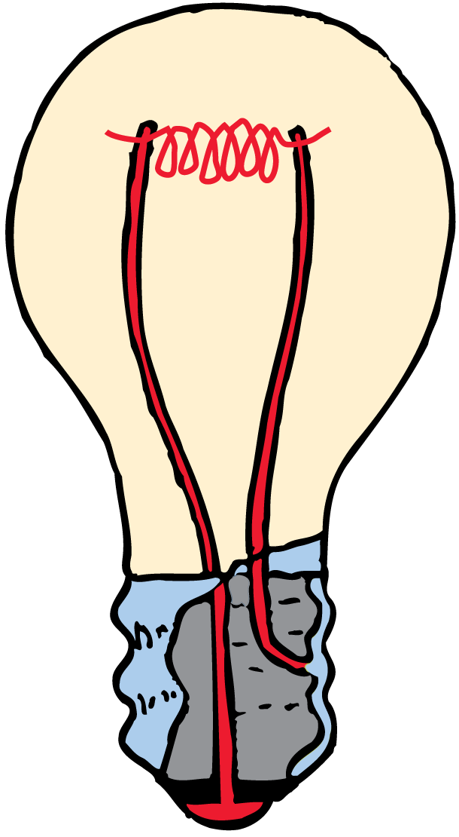
A Battery and a Bulb
Electrons do not pile up inside a bulb, but instead flow through its filament.

Slide 10
Electric Circuits
For a continuous flow of electrons, there must be a complete circuit with no gaps.

Slide 11
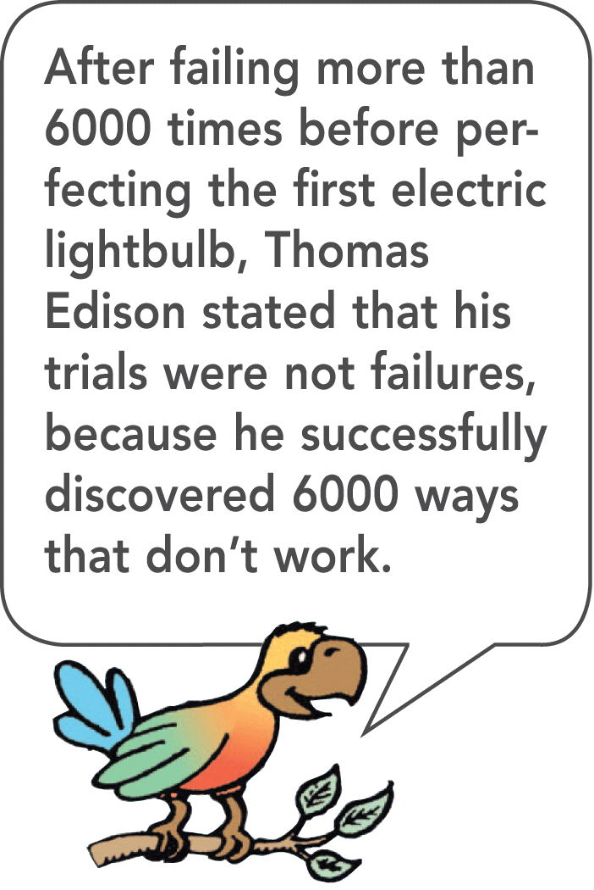
Electric Circuits
Any path along which electrons can flow is a circuit.
A gap is usually provided by an electric switch that can be opened or closed to either cut off or allow electron flow.

Slide 12
Electric Circuits
The water analogy is useful but has some limitations.
  A break in a water pipe results in a leak, but a break in an electric circuit results in a complete stop in the flow.
  Opening a switch stops the flow of electricity. An electric circuit must be closed for electricity to flow. Opening a water faucet, on the other hand, starts the flow of water.

Slide 13
Electric Circuits
Most circuits have more than one device that receives electrical energy.
These devices are commonly connected in a circuit in one of two ways, series or parallel.
  When connected in series, the devices in a circuit form a single pathway for electron flow.
  When connected in parallel, the devices in a circuit form branches, each of which is a separate path for electron flow.

Slide 14
Series Circuits
If one device fails in a series circuit, current in the whole circuit ceases and none of the devices will work.

Slide 15
Series Circuits
If three lamps are connected in series with a battery, they form a series circuit. Charge flows through each in turn.
When the switch is closed, a current exists almost immediately in all three lamps.
The current does not “pile up” in any lamp but flows through each lamp. Electrons in all parts of the circuit begin to move at once.

Slide 16
Series Circuits
Eventually the electrons move all the way around the circuit.
A break anywhere in the path results in an open circuit, and the flow of electrons ceases.
Burning out of one of the lamp filaments or simply opening the switch could cause such a break.

Slide 17
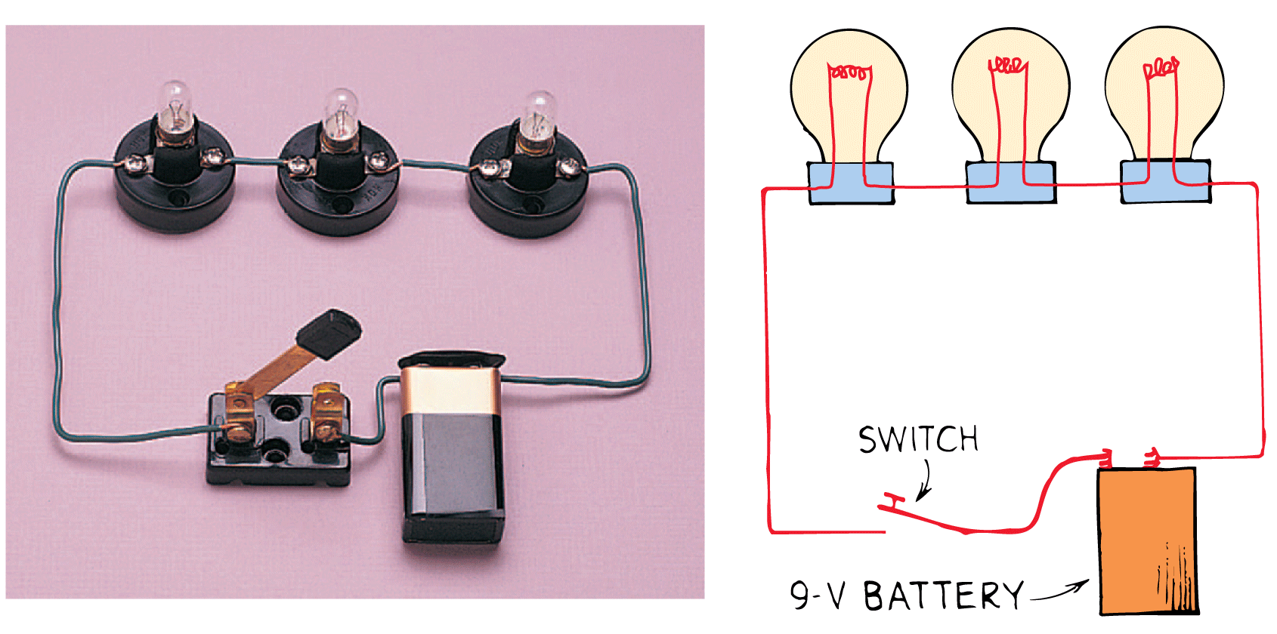
Series Circuits
In this simple series circuit, a 9-volt battery provides 3 volts across each lamp.

Slide 18
Series Circuits
For series connections:
  Electric current has a single pathway through the circuit.
  The total resistance to current in the circuit is the sum of the individual resistances along the circuit path.
  The current is equal to the voltage supplied by the source divided by the total resistance of the circuit. This is Ohm’s law.
  The voltage drop, or potential difference, across each device depends directly on its resistance.
  The sum of the voltage drops across the individual devices is equal to the total voltage supplied by the source.

Slide 19
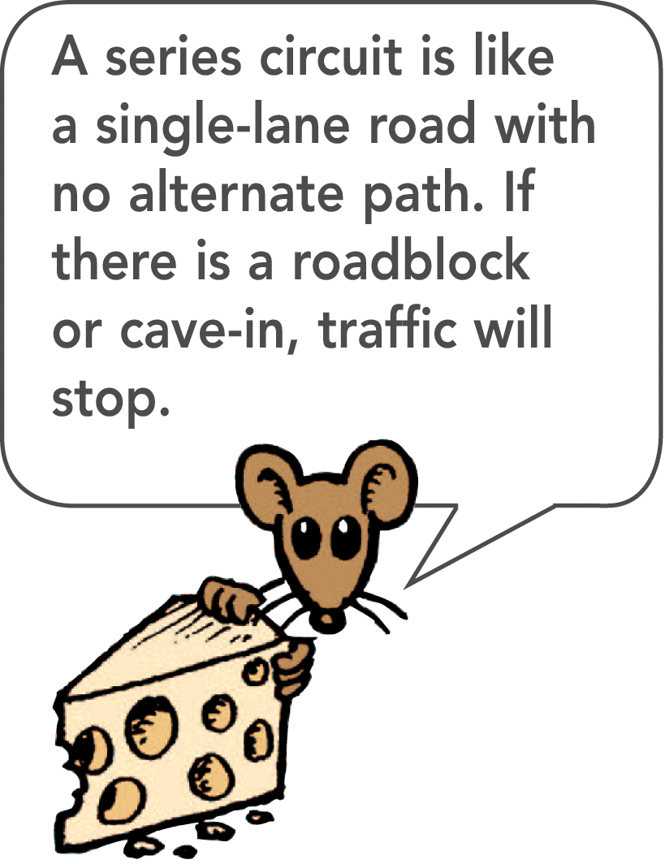
Series Circuits
The main disadvantage of a series circuit is that when one device fails, the current in the whole circuit stops.
Some cheap light strings are connected in series. When one lamp burns out, you have to replace it or no lights work.

Slide 20
Series Circuits
think!
What happens to the light intensity of each lamp in a series circuit when more lamps are added to the circuit?

Slide 21
Series Circuits
think!
What happens to the light intensity of each lamp in a series circuit when more lamps are added to the circuit?
Answer:
The addition of more lamps results in a greater circuit resistance. This decreases the current in the circuit (and in each lamp), which causes dimming of the lamps.

Slide 22
Series Circuits
think!
A series circuit has three bulbs. If the current through one of the bulbs is 1 A, can you tell what the current is through each of the other two bulbs? If the voltage across bulb 1 is 2 V, and across bulb 2 is 4 V, what is the voltage across bulb 3?
Assume 9 V battery.

Slide 23
Series Circuits
think!
A series circuit has three bulbs. If the current through one of the bulbs is 1 A, can you tell what the current is through each of the other two bulbs? If the voltage across bulb 1 is 2 V, and across bulb 2 is 4 V, what is the voltage across bulb 3?
Answer:
The same current, 1 A, passes through every part of a series circuit. Each coulomb of charge has 9 J of electrical potential energy (9 V = 9 J/C). If it spends 2 J in one bulb and 4 in another, it must spend 3 J in the last bulb. 3 J/C = 3 V

Slide 24
Parallel Circuits
In a parallel circuit, each device operates independent of the other devices. A break in any one path does not interrupt the flow of charge in the other paths.

Slide 25
Parallel Circuits
In a parallel circuit having three lamps, each electric device has its own path from one terminal of the battery to the other.
There are separate pathways for current, one through each lamp.
In contrast to a series circuit, the parallel circuit is completed whether all, two, or only one lamp is lit.
A break in any one path does not interrupt the flow of charge in the other paths.

Slide 26
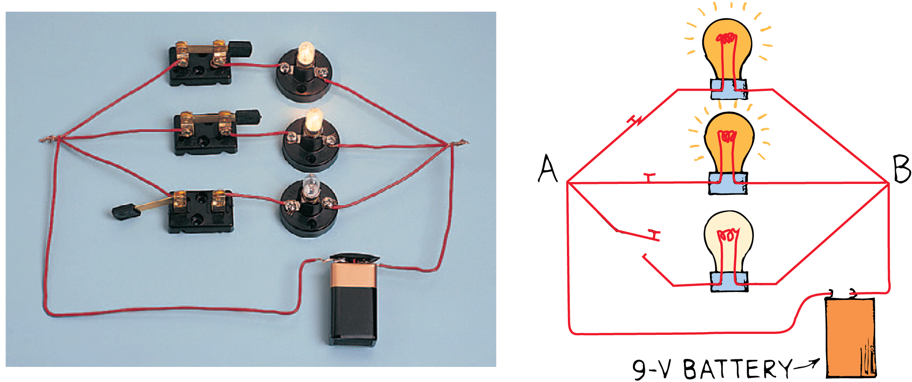
Parallel Circuits
In this parallel circuit, a 9-volt battery provides 9 volts across each activated lamp. (Note the open switch in the lower branch.)

Slide 27
Parallel Circuits
Major characteristics of parallel connections:
  Each device connects the same two points A and B of the circuit. The voltage is therefore the same across each device.
  The total current divides among the parallel branches.
  The amount of current in each branch is inversely proportional to the resistance of the branch.
  The total current is the sum of the currents in its branches.
  As the number of parallel branches is increased, the total current through the battery increases.

Slide 28
Parallel Circuits
From the battery’s perspective, the overall resistance of the circuit is decreased.
This means the overall resistance of the circuit is less than the resistance of any one of the branches.

Slide 29
Parallel Circuits
think!
What happens to the light intensity of each lamp in a parallel circuit when more lamps are added in parallel to the circuit?

Slide 30
Parallel Circuits
think!
What happens to the light intensity of each lamp in a parallel circuit when more lamps are added in parallel to the circuit?
Answer:
The light intensity for each lamp is unchanged as other lamps are introduced (or removed). Although changes of resistance and current occur for the circuit as a whole, no changes occur in any individual branch in the circuit.

Slide 31
Schematic Diagrams
In a schematic diagram, resistance is shown by a zigzag line, and ideal resistance-free wires are shown with solid straight lines. A battery is represented with a set of short and long parallel lines.

Slide 32
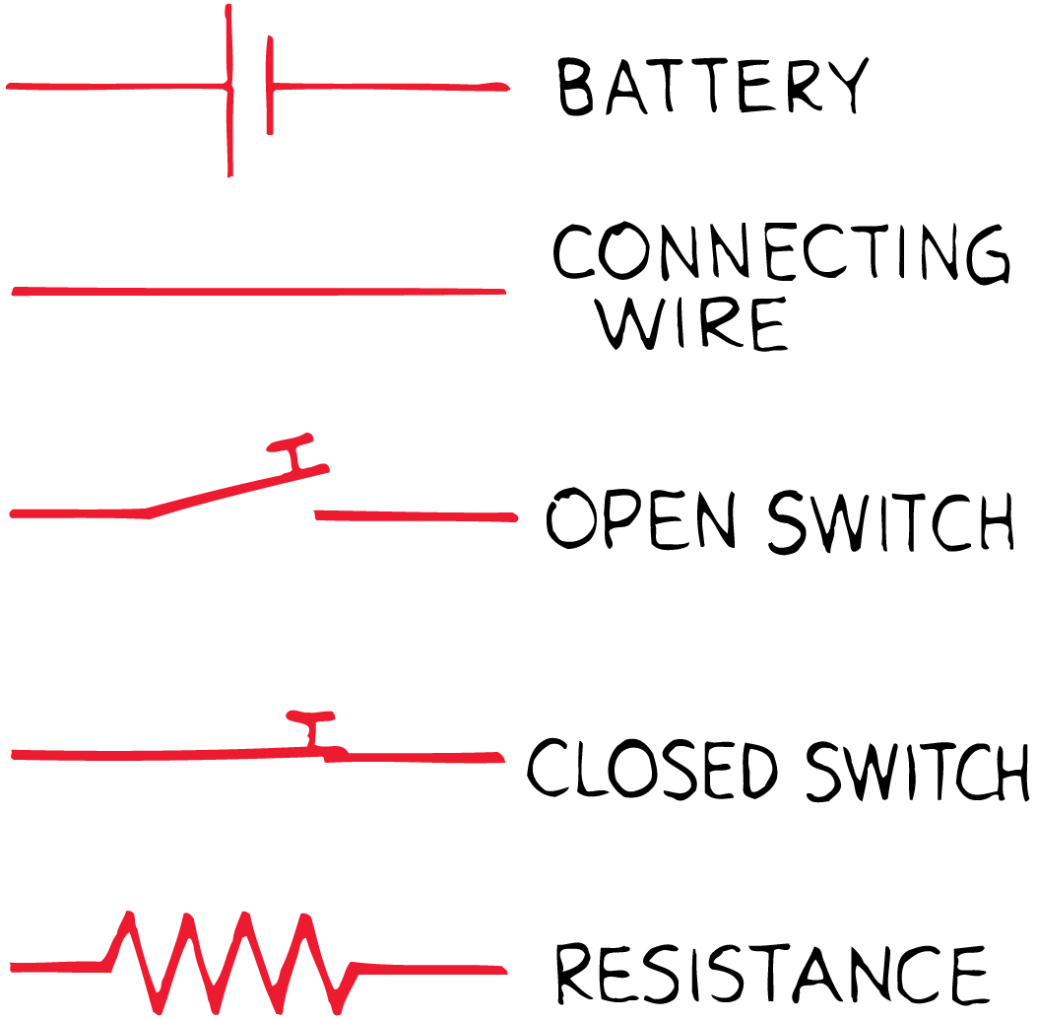
Schematic Diagrams
Electric circuits are frequently described by simple diagrams, called schematic diagrams.
  Resistance is shown by a zigzag line, and ideal resistance-free wires are shown with solid straight lines.
  A battery is shown by a set of short and long parallel lines, the positive terminal with a long line and the negative terminal with a short line.

Slide 33
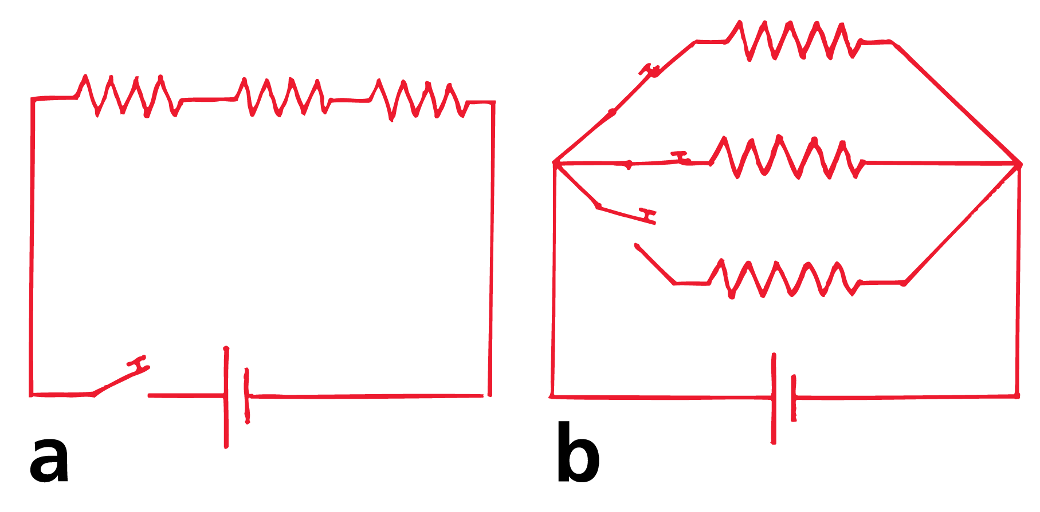
Schematic Diagrams
These schematic diagrams represent
  a circuit with three lamps in series, and
  a circuit with three lamps in parallel.

Slide 34
Combining Resistors in a Compound Circuit
The equivalent resistance of resistors connected in series is the sum of their values. The equivalent resistance for a pair of equal resistors in parallel is half the value of either resistor.

Slide 35
Combining Resistors in a Compound Circuit
Sometimes it is useful to know the equivalent resistance of a circuit that has several resistors in its network.
The equivalent resistance is the value of the single resistor that would comprise the same load to the battery or power source.
The equivalent resistance of resistors connected in series is the sum of their values. For example, the equivalent resistance for a pair of 1-ohm resistors in series is simply 2 ohms.

Slide 36
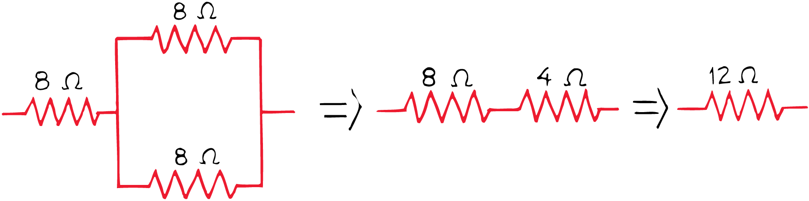
Combining Resistors in a Compound Circuit
The equivalent resistance for a pair of equal resistors in parallel is half the value of either resistor.
The equivalent resistance for a pair of 1-ohm resistors in parallel is 0.5 ohm.
The equivalent resistance is less because the current has “twice the path width” when it takes the parallel path.

Slide 37
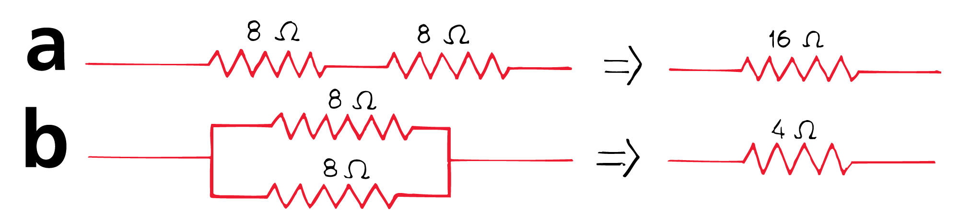
Combining Resistors in a Compound Circuit
The equivalent resistance of two 8-ohm resistors in series is 16 ohms.
The equivalent resistance of two 8-ohm resistors in parallel is 4 ohms.

Slide 38
Combining Resistors in a Compound Circuit
For the combination of three 8-ohm resistors, the two resistors in parallel are equivalent to a single 4-ohm resistor.
They are in series with an 8-ohm resistor, adding to produce an equivalent resistance of 12 ohms.
If a 12-volt battery were connected to these resistors, the current through the battery would be 1 ampere.
(In practice it would be less, for there is resistance inside the battery as well, called the battery’s internal resistance.)

Slide 39
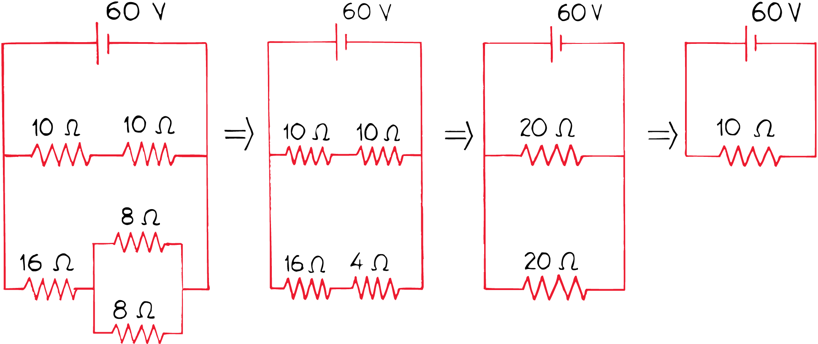
Combining Resistors in a Compound Circuit
think!
In the circuit shown below, what is the current in amperes through the pair of 10-ohm resistors? Through each of the 8-ohm resistors?

Slide 40
Combining Resistors in a Compound Circuit
think!
In the circuit shown below, what is the current in amperes?
Answer:
Since the voltage is 60 V, the current = (voltage)/(resistance) =
(60V)/(10 Ω) = 6 A.

